Slide 1
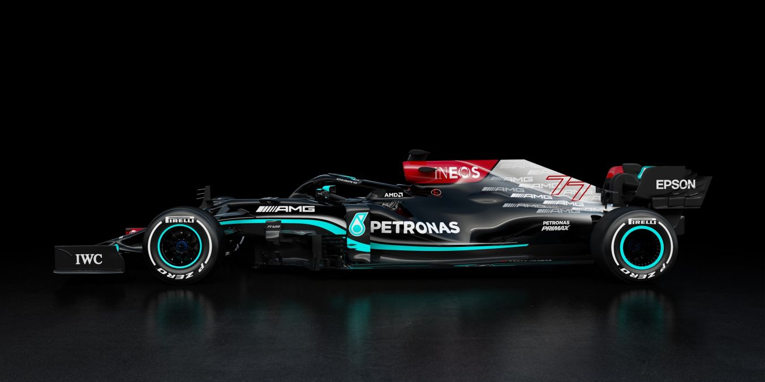
Mercedes AMG F1
As seen though Brain, Organism, and Psychic Prison

Slide 2
Shared Knowledge
While engaging with this project I found that the most useful tool was the shared knowledge that we have established as a class in our weekly reflections, metaphors compared and contrasted, and our pressbooks.
Thank you for helping me understand these metaphors!☺

Slide 3
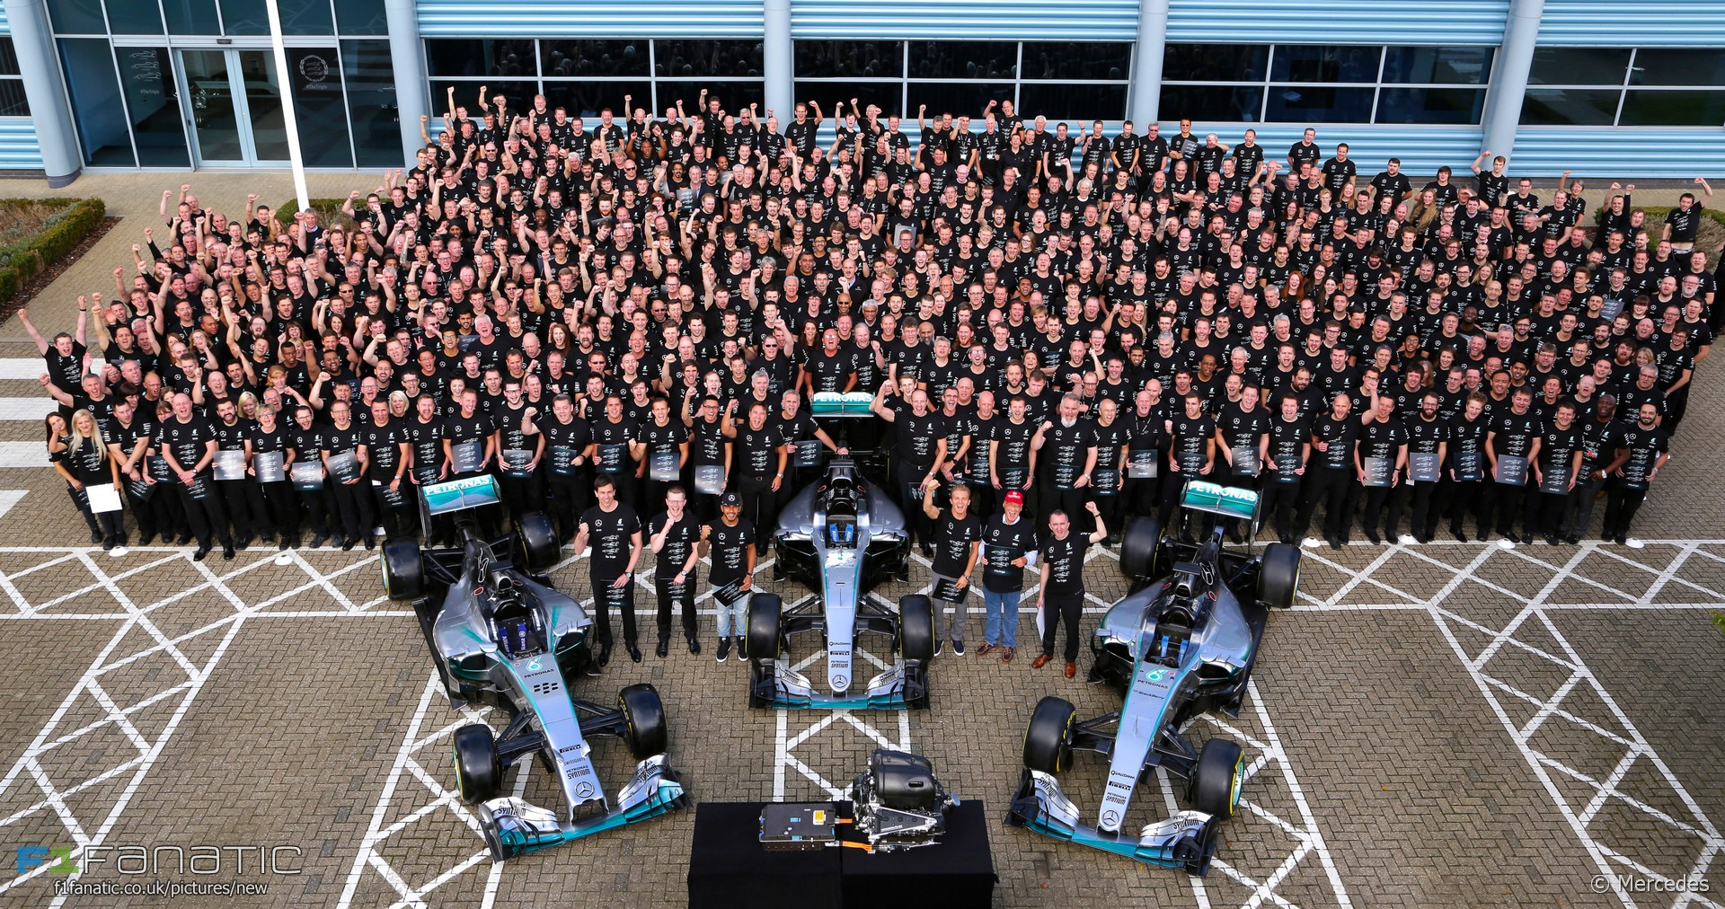
Factory Team
Mercedes F1 is made up of a total of over 6,000 team members

Slide 4
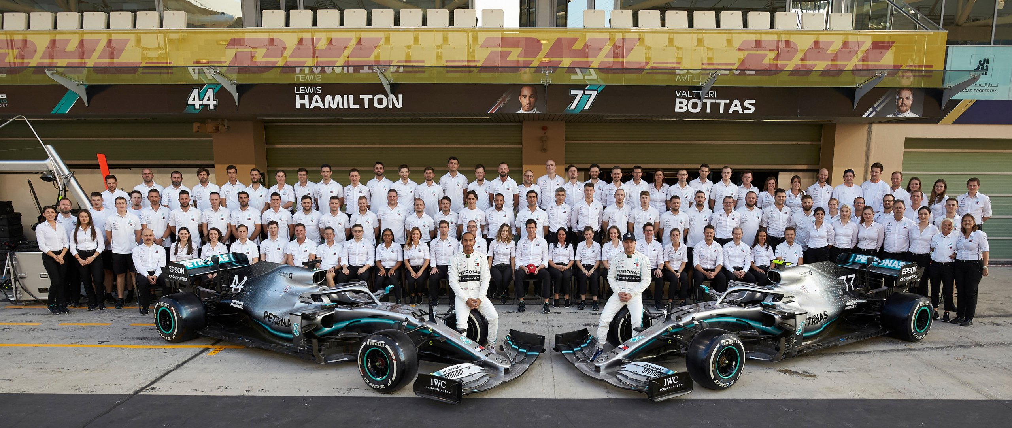
On Track Team
Mercedes track team is made up of, the pit crew, mechanics, strategists, team principal and many others

Slide 5
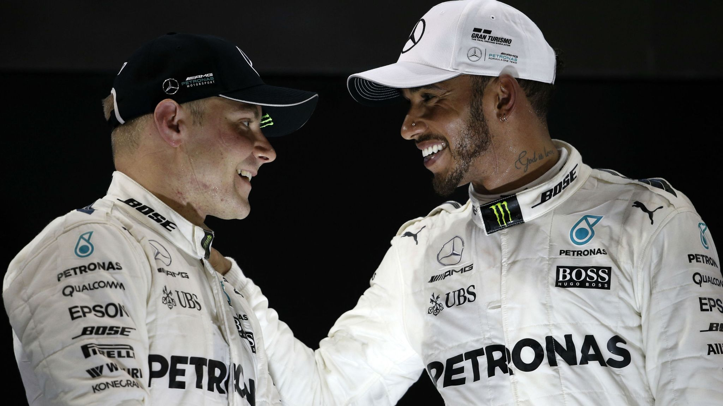
Drivers

Slide 6
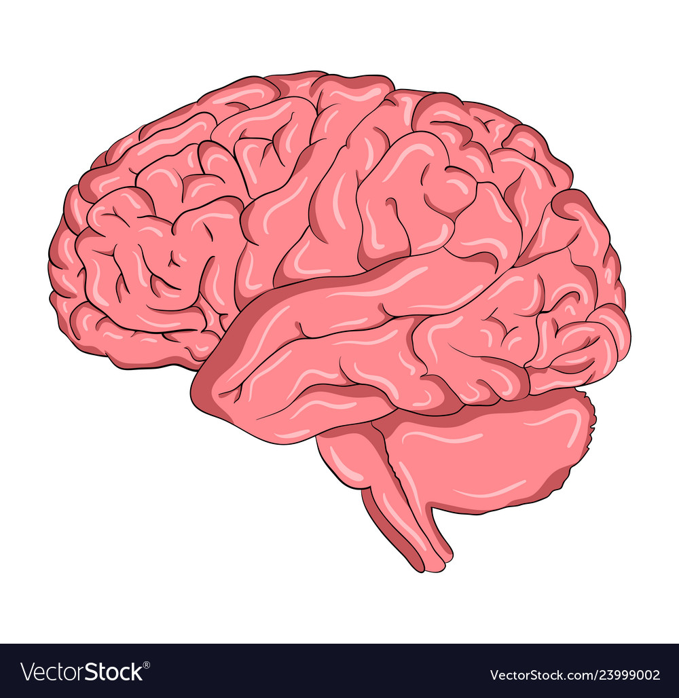
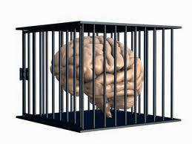
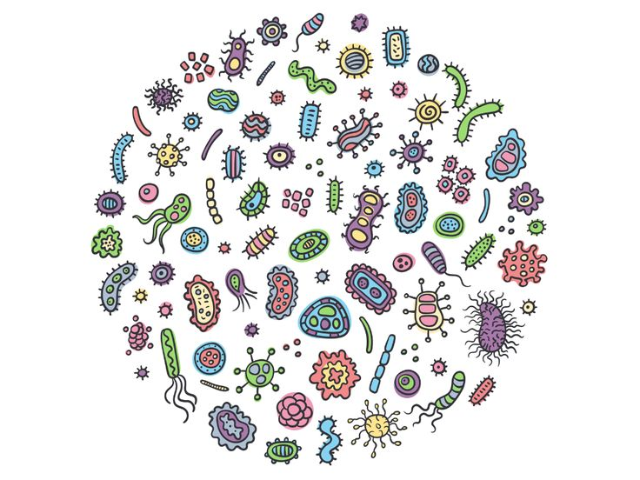

How is Success Sustained?
Mercedes winning streak is representative of a healthy and productive organizational environment in which sustained success can be viewed though organizational metaphors
Brain
Organism
Psychic Prison
Notes:
Have won the constructors championship every year since 2014 – are on track to win another.

Slide 7
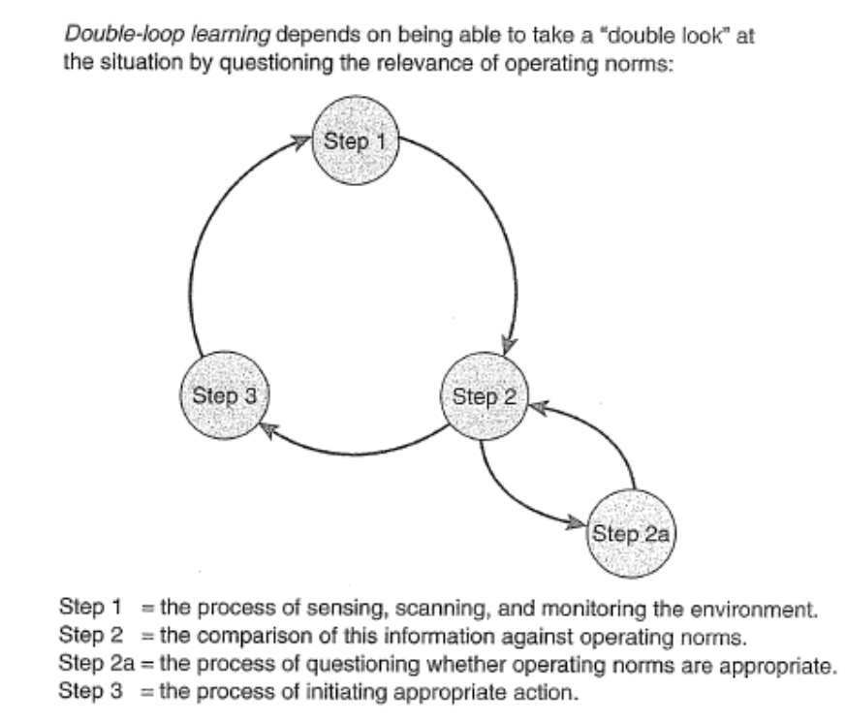

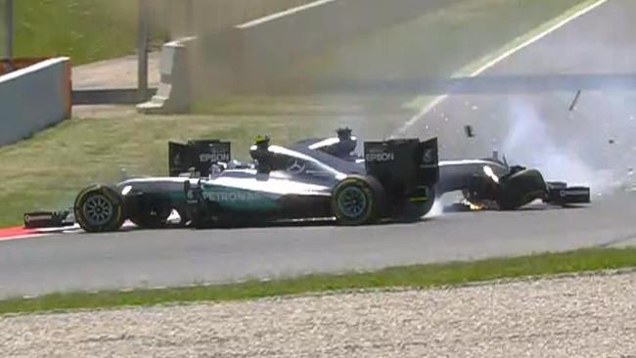
Brain
In order to achieve their success Mercedes F1 is learning, collaborative, adaptive and resilient
Double-Loop Learning
Diversity Commitment
Learning From Mistakes
Notes:
Norms are male dominance. F1 is dominated by white men. Mercedes in an effort to reevaluate their progress against the norms, and evaluate the norms has engaged in diversity efforts. Double loop – Diversity efforts – 2025 effort for 25% of underrepresented groups. Also heavily involved in getting more women in stem

Slide 8
"If broken, any single piece can be used to reconstruct the entire image. Everything is enfolded in everything else, just as if we were able to throw a pebble into a pond and see the whole pond and all the waves, ripples, and drops of water generated by the splash in each and every one of the drops of water thus produced" (Morgan 73).
Team Principal
Aerodynamics
Research and Development
Pit Crew
Driver 1
Simulation
Assembly
Mechanics
Driver 2
Strategy
General Engineering

Slide 9
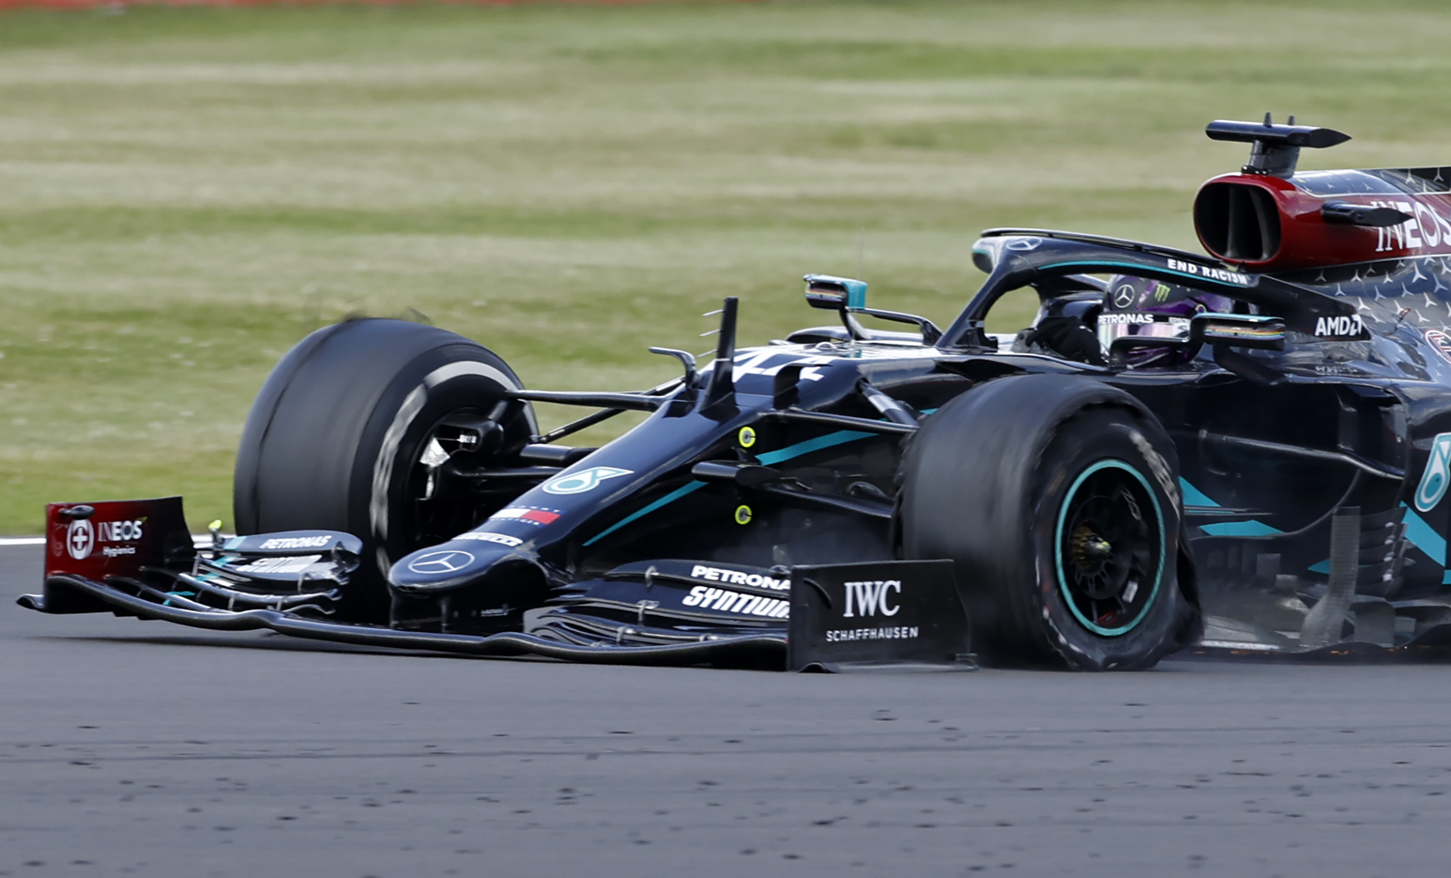
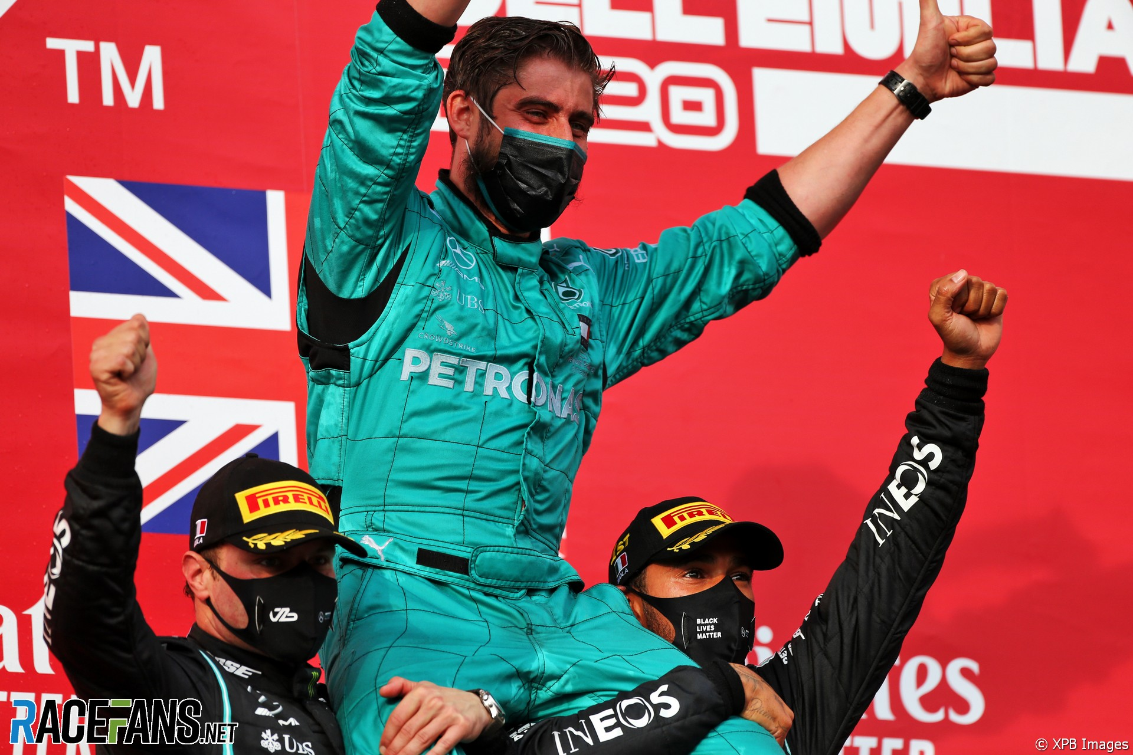
Mercedes F1 As Organism
“Organization theory has become a kind of biology in which the distinctions and relations among molecules, cells, complex organisms, species, and ecology are paralleled in those between individuals, groups, organizations, populations (species) of organizations, and their social ecology” (Morgan, 34).
All employees must feel valued
Lack of organizational harmony = flat tire!
Mercedes drivers bringing their engineer on the podium
Notes:
Make employees feel useful and important by giving them meaningful jobs, autonomy, and respect → job enrichment/employee centered style of leadership trumps authoritarian leadership style. Employees are a valuable resource, they should be treated that way.

Slide 10



Fluid F1 Environment
Organizations are open systems defined by their environments and must adapt to them
Survival of the fittest
Technical Regulations
Technical Failures
Competition!
Financial Regulations
Collaboration & Allyship!
Protests
Other teams
Notes:
The day can be defined by a change in environment, or a change in technological systems/market systems. Problems posed by these changes require open and flexible styles of organizational management.

Slide 11

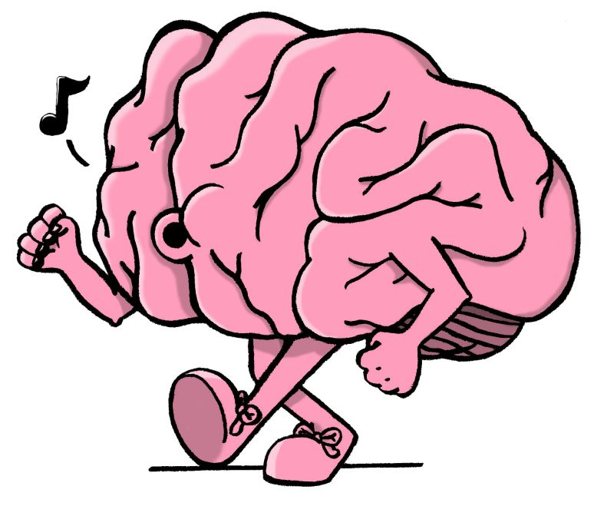
Psychic Prison
In order to sustain success Mercedes defies the psychic prison of f1

Slide 12
Appendix

Slide 13
How is Success Sustained?
Mercedes winning streak is representative of a healthy and productive organizational environment in which sustained success can be viewed though organizational metaphors
Brain
Organism
Psychic Prison
Learning
Replication
Self realization → 2025 inclusion plan
Adaptation to tumultuous environment
Internal Harmony
Vitality of individual parts
Allyship with other teams
The norm isn’t good enough
Anti-groputhink
Notes:
Won constructors championship every year since 2014

Slide 14
Double-Loop Learning

