Slide 1
Reimagining Boarding Schools
Amya Bolden and Angel Li

Slide 2
Introduction
“A boarding school is an institution where children live within premises while being given formal instruction. The word "boarding" is used in the sense of "room and board", i.e. lodging and meals. As they have existed for many centuries, and now extend across many countries, their function and ethos varies greatly” (Wikipedia).
Pros | Cons
Independence | Independence
Sense of community | Mental health, stress
High quality of education

Slide 3
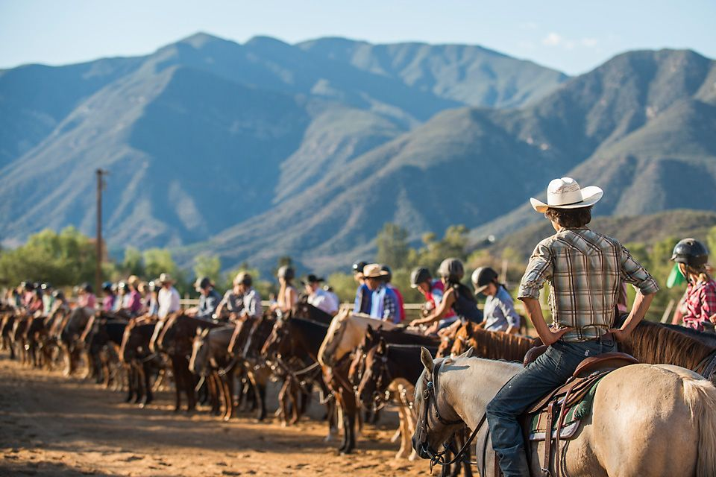
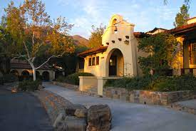
The Thacher School
Located in Ojai, California
Founded in 1889 as an all-boys school
Co-ed, 9-12, boarding & day
Horse & Outdoor Programs
Honor, Fairness, Kindness, Truth

Slide 4
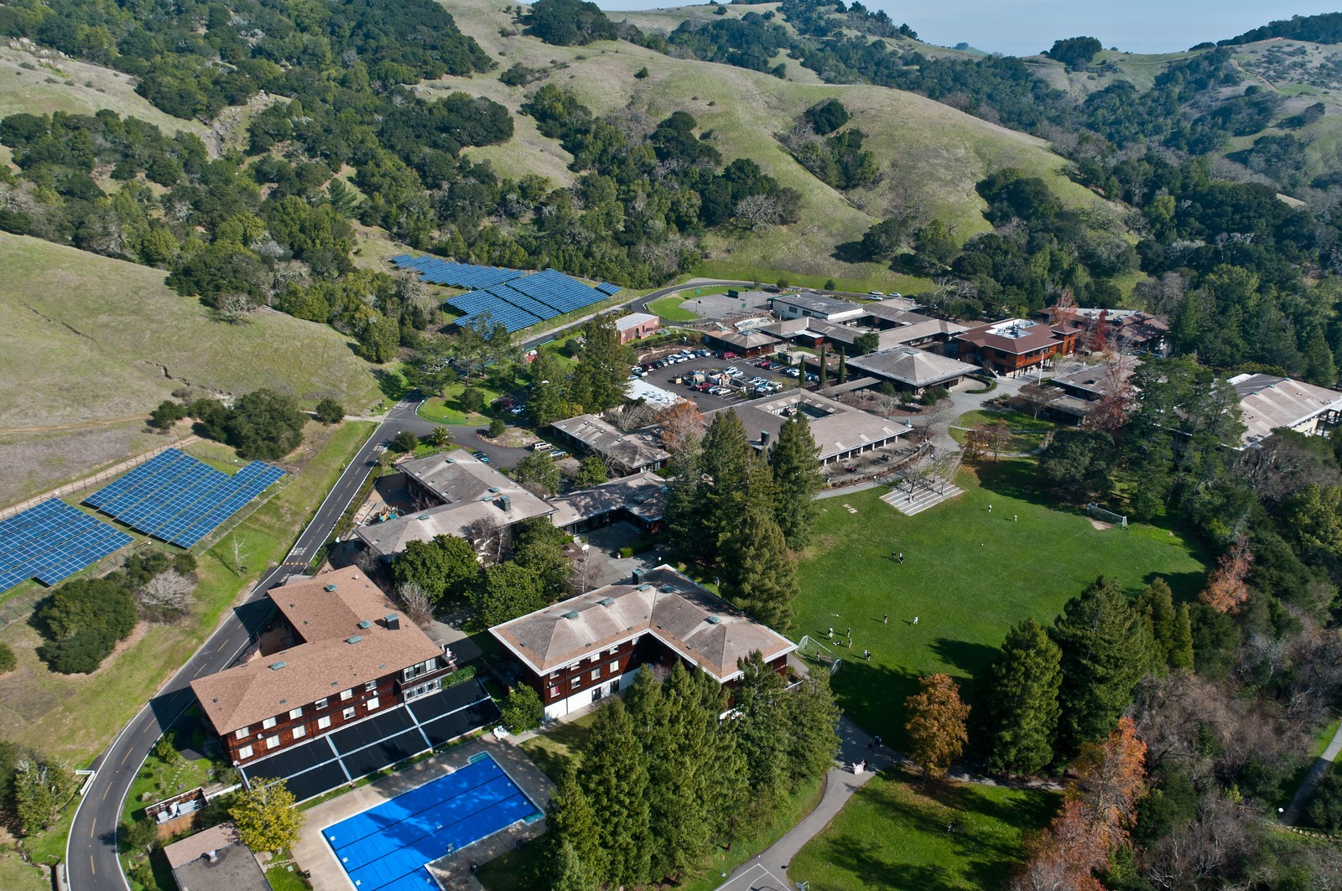
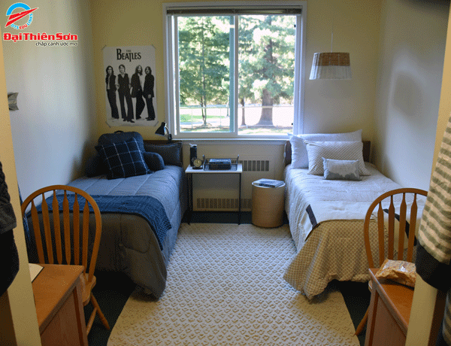
San Domenico School
Located in San Anselmo, Marin County, CA
Founded in 1850 by the Dominican Sisters
Co-ed K-12, day and boarding
Dominican Catholic heritage which calls us to uphold the values of study, reflection, service and community

Slide 5
Metaphorical Analysis
Machine
School’s expectation – students to follow schedule
Strict rules during study hours, assembly meetings, dining hall
Psychic Prison
Academics, college applications, personal life, all aspects of life are mixed together
Peer Pressure and comparison; constantly surrounded by other students
Domination
“Dorm parent”
Absence of “parental protection” for each student individually
Procedures: submitting forms to go home on weekends

Slide 6
A Reimagined Future
Students are not machines
Be flexible, understanding, personal
More transparency between school administrators and parents/guardians
Communication: meetings that include all parties (students, parents, and administrators) for important matters
Counseling support
Diverse backgrounds (race, gender, sexual orientation, etc.)

Slide 7
Conclusion
These are kids!!
Be the “home” away from home
Boarding Schools have the ability to be extremely positive living and learning communities when students are NOT treated as machines and cycles of psychic prison and domination are eliminated.

Slide 8
Acknowledgements & Sources
Amya - “thank you to iona, whitney, and all my friends at thacher, also to my mom, barbara, and everyone in org theory!”
Angel - “parents, barbara, everyone in ORST100”
Morgan & Grey

